Slide 1
Final Project Spaceship Titanic
Gustavo Soares da silva Barros

Slide 2
Spaceship Titanic Table of content
What is it?
Objectives
Data Cleaning and Feature Extraction
EDA
Machine Learning
Final Results
Areas of improvement

Slide 3
Spaceship Titanic What is it?
Competition on Kaggle
Start date: feb 23, 2022
Notes:
The Spaceship Titanic was an interstellar passenger liner launched on year 2912 transporting almost 13,000 passengers, from our solar system to three newly habitable exoplanets orbiting nearby stars.
While rounding Alpha Centauri en route to its first destination, 55 Cancri E, the Spaceship Titanic collided with a spacetime anomaly hidden within a dust cloud. Though the ship stayed intact, almost half of the passengers were transported to an alternate dimension!
To help rescue crews and retrieve the lost passengers, you are challenged to predict which passengers were transported by the anomaly using records recovered from the spaceship’s damaged computer system.

Slide 4
Spaceship Titanic Objectives
Competition
Predict wich passengers are transported to an alternate dimension
Project
Compare different ML algorithms
Build a complete pipeline

Slide 5
Spaceship Titanic Data Cleaning and FE
 | Nulls %
PassengerId | 0.00
HomePlanet | 2.31
CryoSleep | 2.50
Cabin | 2.29
Destination | 2.10
Age | 2.06
VIP | 2.33
 | Nulls %
RoomService | 2.08
FoodCourt | 2.10
ShoppingMall | 2.39
Spa | 2.10
VRDeck | 2.16
Name | 2.30
Transported | 0.00

Slide 6
Spaceship Titanic Data Cleaning and FE
 | PassengerId
0 | 0001_01
1 | 0002_01
2 | 0003_01
3 | 0003_02
4 | 0004_01
5 | 0005_01
6 | 0006_01
7 | 0006_02
8 | 0007_01
9 | 0008_01
PassengerId
GroupNumber
(gggg_)
PassengerNumber
(_pp)
GroupSize

Slide 7
Spaceship Titanic Data Cleaning and FE
 | Cabin
0 | B/0/P
1 | F/0/S
2 | A/0/S
3 | A/0/S
4 | F/1/S
5 | F/0/P
6 | F/2/S
7 | G/0/S
8 | F/3/S
9 | B/1/P
Cabin
Deck
Cabin
Number
Side

Slide 8
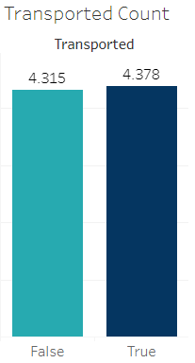
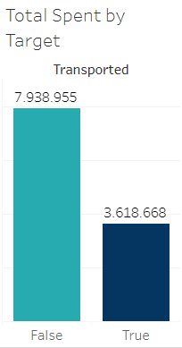
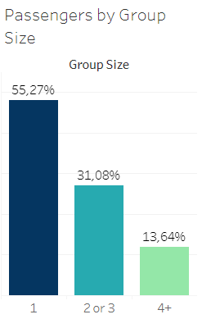
Spaceship Titanic EDA
Notes:
These numbers stands for the training set.

Slide 9
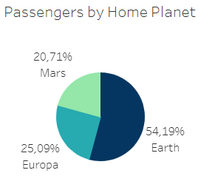
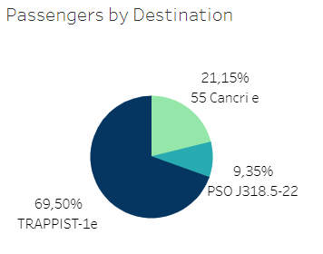
Spaceship Titanic EDA

Slide 10
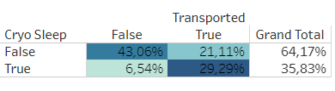
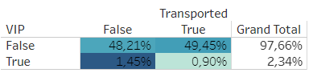
Spaceship Titanic EDA

Slide 11
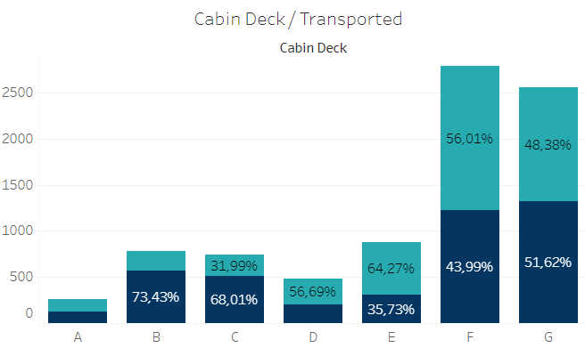

Spaceship Titanic EDA

Slide 12
Spaceship Titanic Machine Learning
Logistic Regression
KNN
Decision Tree
Random Forest
XGBoost
Classification Score (Validation Set):
78.41%
76.64%
77.83%
78.87%
79.40%

Slide 13
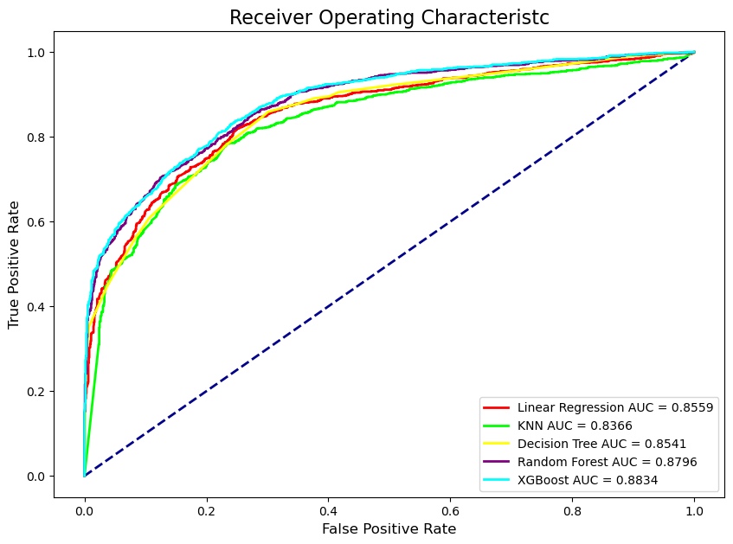
Spaceship Titanic Machine Learning

Slide 14
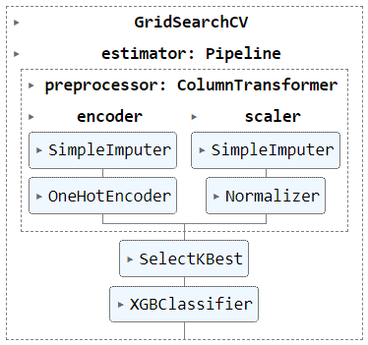
Spaceship Titanic Machine Learning

Slide 15
Spaceship Titanic Final Results
First Prediction
Logistic Regression
Classification Score = 78.372%
Final Prediction
XGBoost
Classification Score = 79.565%

Slide 16
Spaceship Titanic Areas of Improvement
Data Cleaning
Feature Engineering

Slide 17
Spaceship Titanic
github.com/gustavossbarros/Ironhack_Final_Project_Spaceship_Titanic

Slide 18
Thank you!

